Slide 1

Business Analytics with R Project
Nikita Gorathe

Slide 2

Goals and Objectives
Analyze various Ted Talks and build a predictive model which can be used by TED to
Achieve maximum views and increase its user base
Increase the popularity of Talks in advance
Spur a viral spread to attract more viewers
Entice more sponsorships and corporate collaborations
And thereby increase its revenue

Slide 3
Industry Analysis
Media and entertainment Industry- Specifically, Video-on demand and Live streaming services provider and content creator
Why is it relevant?
Live streaming is going to be a $70.5 billion industry by 2021
Increasing popularity due to high-speed internet and easy accessibility
Growing business organization’s attraction towards popular e-learning programs initiatives
Conferences and speakers are at second place at 43% for most watched live content

Slide 4
Porter’s Five Forces
Competitive Rivalry (LOW)
Market dominance due to large scale operations, innovation and first entrants
Threat of New Entrants (HIGH)
Bargaining Power of Customers (MODERATE)
Availability of Substitute Products (MODERATE)
Bargaining Power of Suppliers (LOW)
Differential Advantage with the streamers but the focus being on unique
Create their own streaming content with wide spread distribution channel
Creative and reliable brand image
Easy to enter the market
achieve high profitability with less initial cost
Only a few like Thinkr, Creative Mornings not covering broader themes and audience
Diligent followers

Slide 5
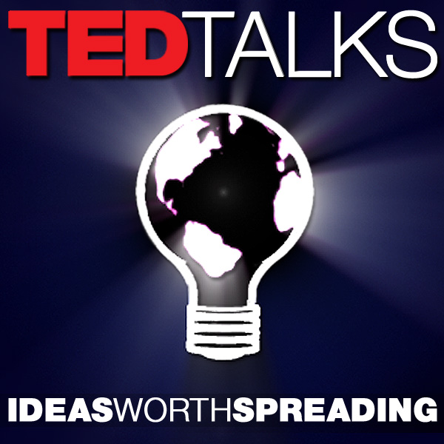
TED Conference LLC
Firm Description
TED is a nonprofit devoted to spreading ideas, usually in the form of short, powerful talks
TED began in 1984
+ 3000 talks From science to business to global issues — in more than 100 languages.
The TED staff consists of about 180 people headquartered in New York city and Vancouver.
Revenue‎: ‎US$66.2 million (2015)
TED is currently funded by a combination of various revenue streams, including conference attendance fees, corporate sponsorships, foundation support, licensing fees, and book sales.
Corporate sponsorships are diverse provided by companies such as GE, AOL, Goldman Sachs, Google and The Coca-Cola Company

Slide 6
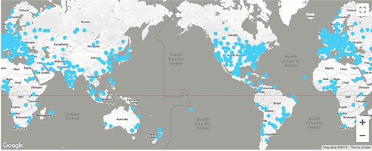
Geographic Footprint
The main TED conference is held annually in Vancouver, British Columbia, Canada at the Vancouver Convention Centre
TED events are also held throughout North America and in Europe, Asia and Africa, offering live streaming of the talks

Slide 7
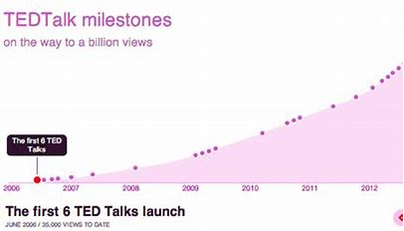
TED Product and Service Line
Programs and Initiatives: TED Talks, TED-Ed, TED Books, TEDx, TED Conference, TED Institute, TED Podcasts
TED stands for Technology, Entertainment, Design — three broad subject areas that are collectively shaping our world. But a TED conference (subject to analysis) is broader still, showcasing important ideas from any discipline, and exploring how they all connect
Types of TED conferences:
TED- The breadth of content includes science, business, the arts, technology and global issues
TED Global- TEDGlobal is a conference that celebrates human ingenuity by exploring ideas, innovation and creativity from all around the world
TED Women- TEDWomen is a three-day conference about the power of women and girls to be creators and change-makers
TED Youth- TEDYouth is a day-long event for middle and high school students, with live speakers, hands-on activities and great conversations
TED Fellows- TED Fellows were introduced in 2007, during the first TEDAfrica conference in Arusha, Tanzania, where 100 young people were selected from across the continent

Slide 8
SWOT
STRENGTHS
WEAKNESSES
OPPORTUNITIES
THREATS
accessible format, available in copious languages, subtitles and categorization through tags
have become some sort of 'beacon of intellectual light’
Available for free on the user-friendly website
Often, points of argument are left unsaid or not justified, which could affect the ethos of the speaker
For short duration talks, the information presented is not very comprehensive
Vast variety of topics that can be covered for every upcoming TED Conference
Alternative to ted conference- Creative Mornings, Idea City, 99u, Pop Tech
Negative themes/topics may adversely affect the audience and in-turn harm the brand image
Expand to new markets and service lines
Cobranding

Slide 9
Data Description
All recordings of TED Talks posted on its official website from 2006 till 2017
Number of Records = 2550 Number of Fields = 17
Target variable = VIEWS
Reference link: https://www.kaggle.com/rounakbanik/ted-talks
Data Source = Kaggle

Slide 10
Dataset Fields Description
Comments:
number of comments made on the talk
Description:
A blurb of what the talk is about
Duration:
duration of the talk in seconds
Event: TED/TEDx event where the talk took place
Film date:
Unix timestamp of the filming
Languages:
The number of languages in which the talk is available
Main Speaker:
The first named speaker of the talk
Name:
official name of the TED Talk. Includes the title and the speaker
Num_speakers : number of speakers in the talk
Published date:
Unix timestamp for the publication of the talk on TED.com
Ratings:
various ratings given to the talk
Related talks:
list of dictionaries of recommended talks to watch next
Speaker Occupation: occupation of the main speaker
Tags:
themes associated with the talk
Title:
The title of the talk
URL:
URL of the talk
Views:
number of views on the talk

Slide 11
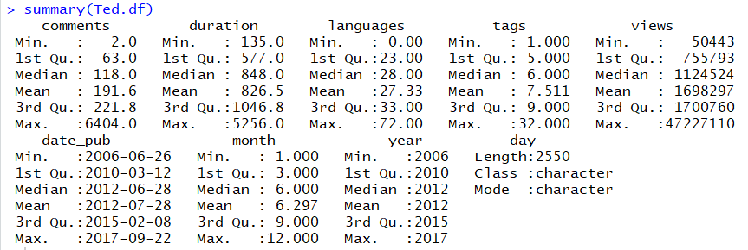
Descriptive Statistics

Slide 12

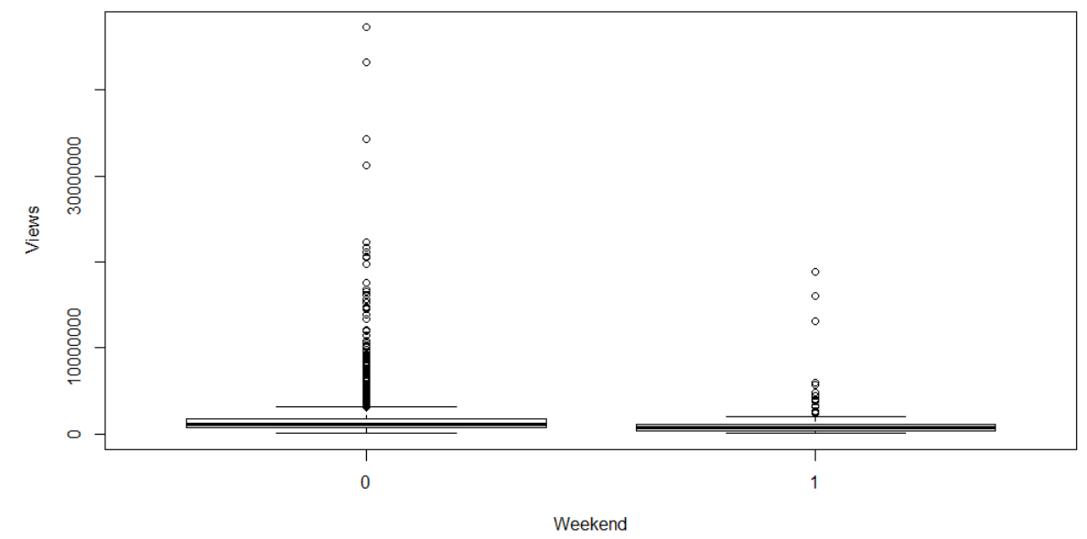
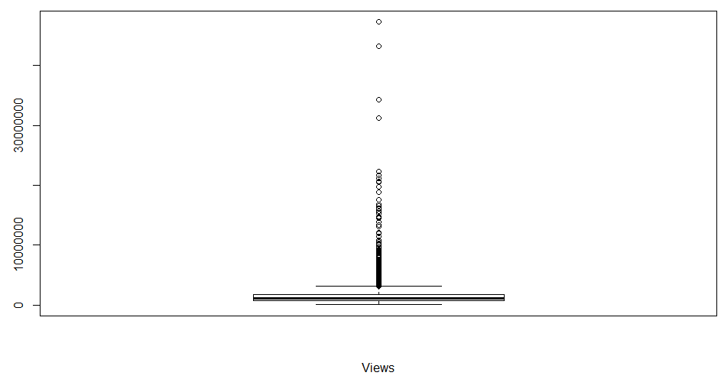
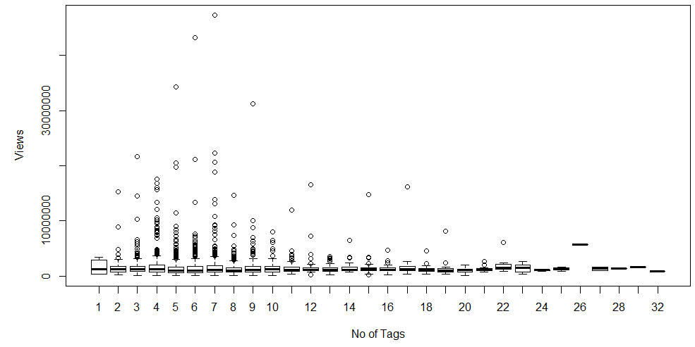
Box Plots
As number of tags increases, the average views also increases
The outliers reduce with increase in number of tags
The average views is more when a Ted Talk is published on a weekday as compared to a weekend

Slide 13
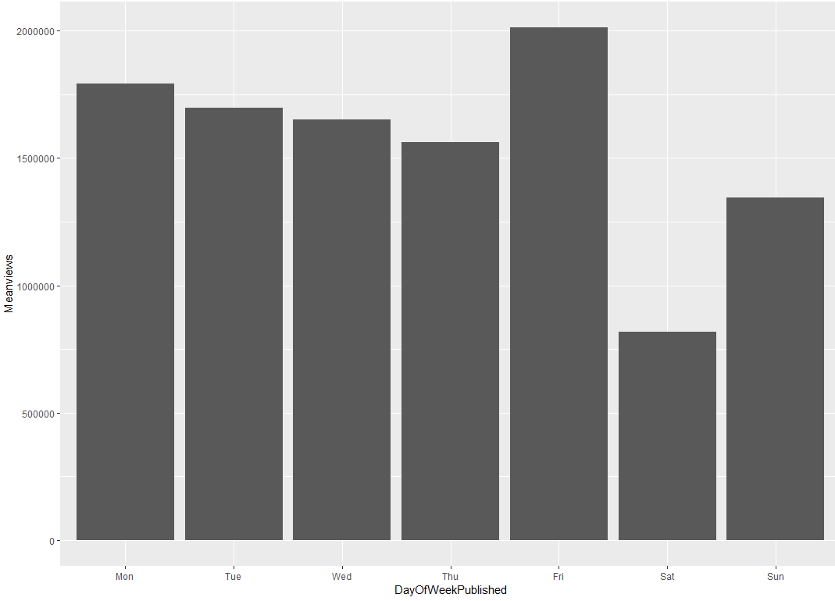
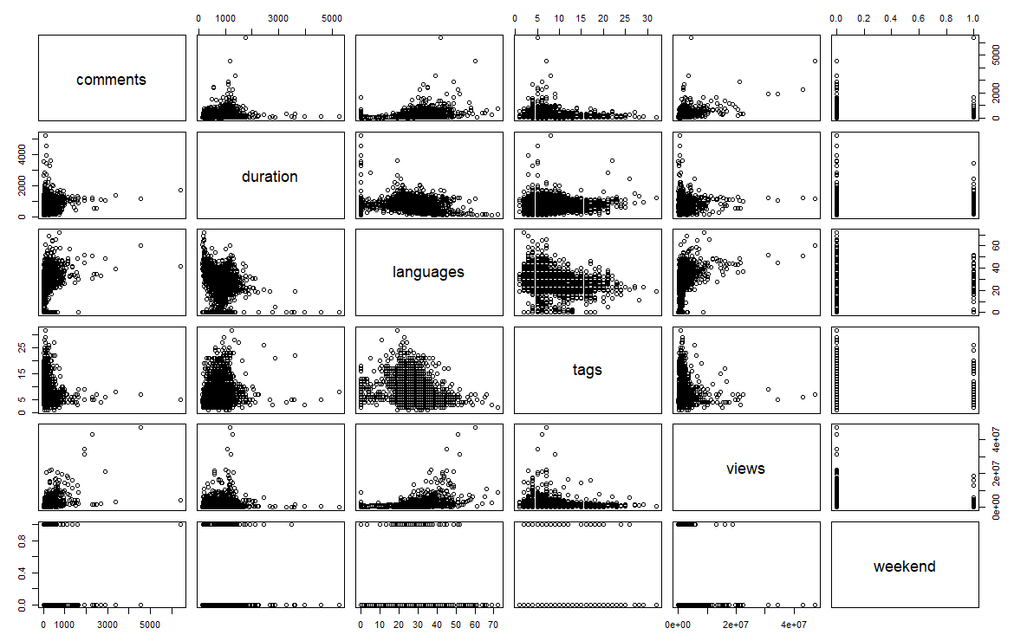
Scatter plots
Ted Talks published on weekends have less views with Saturday being lowest and Friday is the most popular day.
Duration have no consistent correlation with views

Slide 14
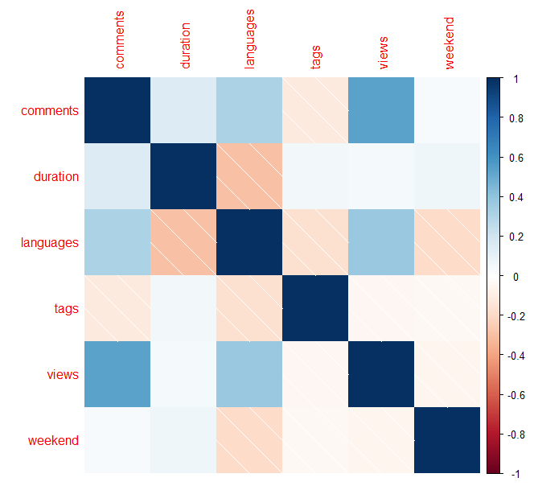
Correlation Matrix
There is a high correlation between number of comments and views (more audience more comments)
There is a positive correlation between number of language translation and number of views and comments
A negative correlation between duration and number of language translations

Slide 15
Goals and Objectives of the Model
The target variable is VIEWS, which gives the number of times a Ted Talk has been viewed
To understand the most influential factors for popularity of a Ted Talk and predict the number of views using those factors/variables
The model helps in accomplishing the goal of maximizing the views in advance. This will help Ted Conference LLC to attract more audience for their upcoming Ted Talks and make each Talk more popular

Slide 16
Building the Model
To build a regression model as the target variable VIEWS is a numerical continuous variable ranging from 50K to over 47M
The published date field in the dataset is transformed into day of week and then categorized to weekend and weekday
The fields used for this model are views, comments, languages, duration, number of tags and published day with the dataset having no missing values

Slide 17
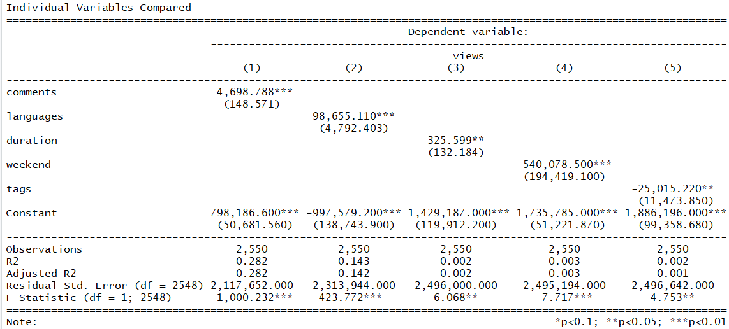
Regression Model – Individual Variables
Regression of number of views performed on each variable of interest separately to see which variable has explanatory power and how strong is it

Slide 18
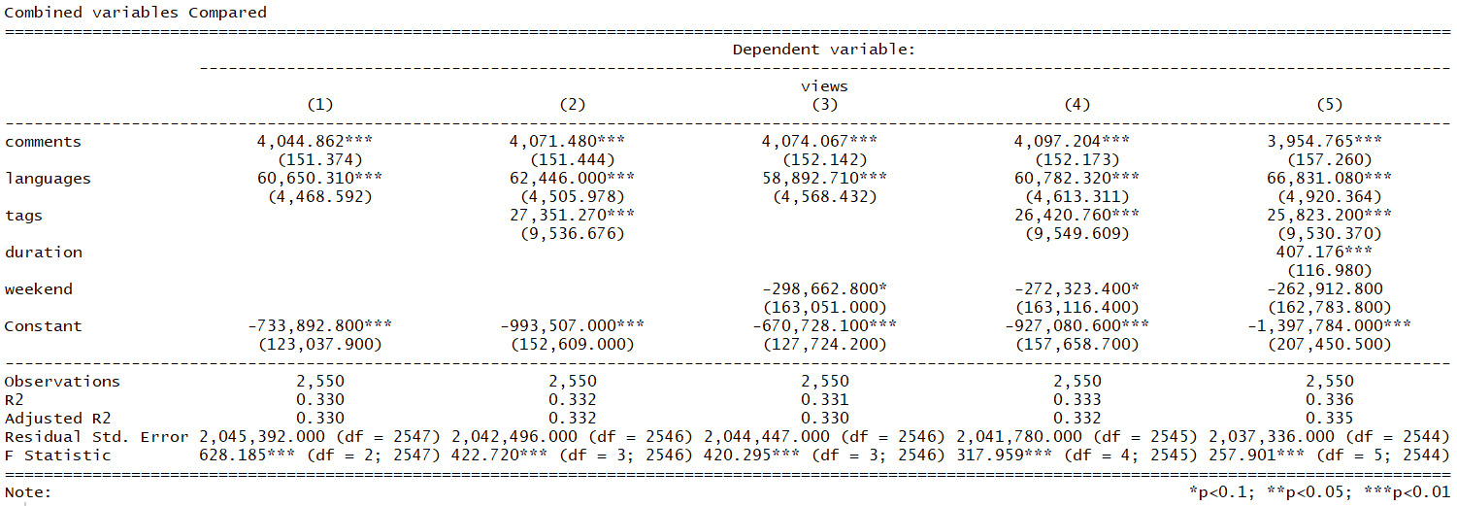
Regression Model – Combined Variables
Regression of number of views performed on combination of variables to check for any improvement in model performance

Slide 19
Model Performance
Model 5 which contains all the chosen variables has the best explanatory power in terms of R squared, adjusted R squared, p value and F-statistic
Although this model (R-squared of 0.336) have only marginal improvements over model 1 with only comments and languages translated
The chosen model suggests that every additional comment is associated with 4,044 more views (p-value < 0.01) and every additional language translated is associated with 60,650 more views (p-value < 0.01); these together explain 0.330 of the variance
Y(views) = -733892 + 4044*comments + 60650*languages
The only limitation of the chosen model having two variables is that it gives slightly less accurate predictions as compared to having all the variables; there is a trade-off between prediction accuracy and cost of the model and the chosen model balances this as it considers only two variables but at the cost of reduced accuracy

Slide 20
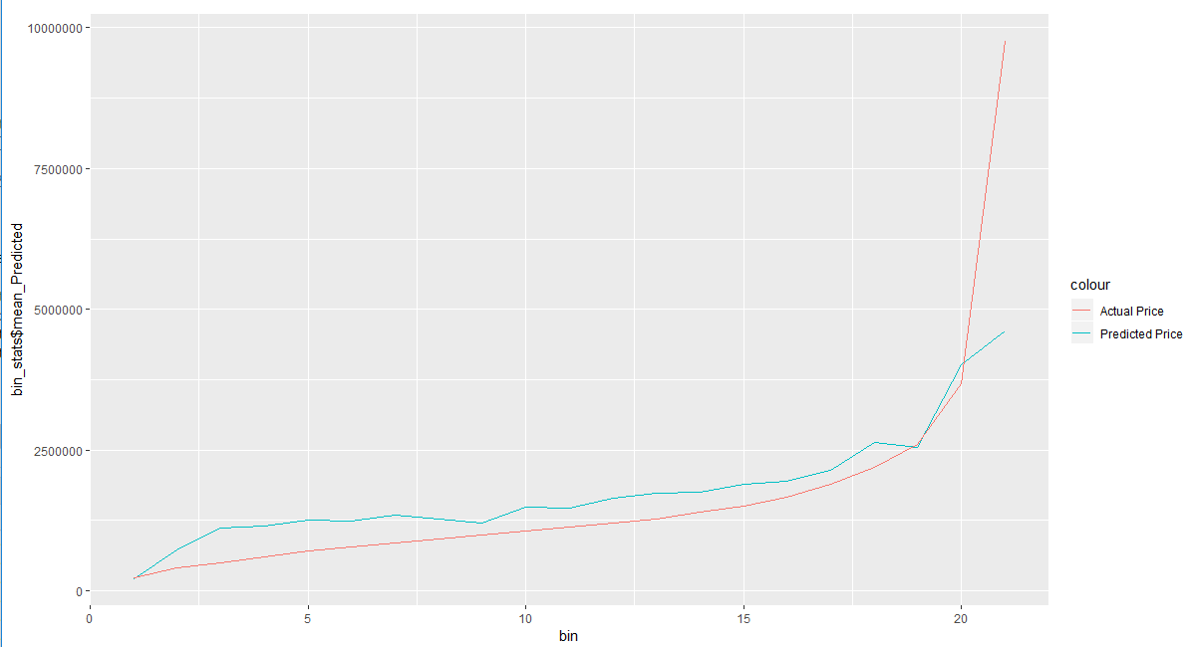
Predicted vs Actual
There is not much difference between the actual and predicted values for regression of the chosen model

Slide 21
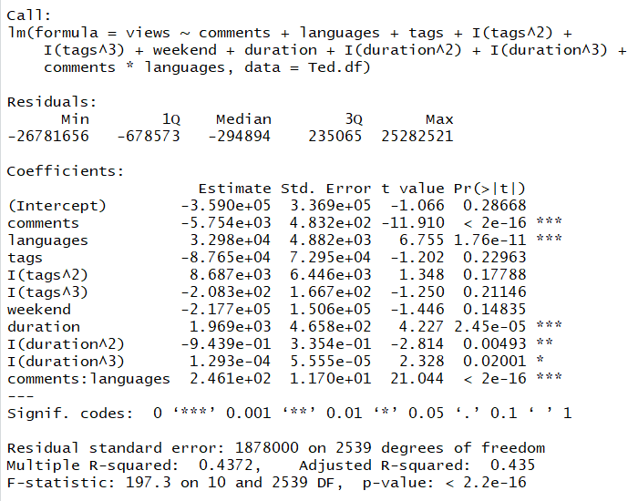
Model Improvement
Regression with polynomials of tags and duration upto third degree, and adding interaction term between number of comments and number of languages made a significant contribution improving the accuracy with R-squared 0.437 and Adj R-squared 0.435

Slide 22
Recommendations
In order to maximize the popularity of Ted Talks and increase its views
Get maximum comments: It is likely that more views earns more comments, but it is also likely that causality goes both ways here;
the more comments -> even more views
Translate to many languages: This also has double-sided causality
more views -> more translations -> more audience-> even more views
To be uploaded on a weekday, preferably Friday: Uploading on a weekend have a negative effect; but undeniably the correlation between day of week to number of average views showed talks that are uploaded on weekdays, and particularly on Fridays, are significantly more popular than weekends

Slide 23
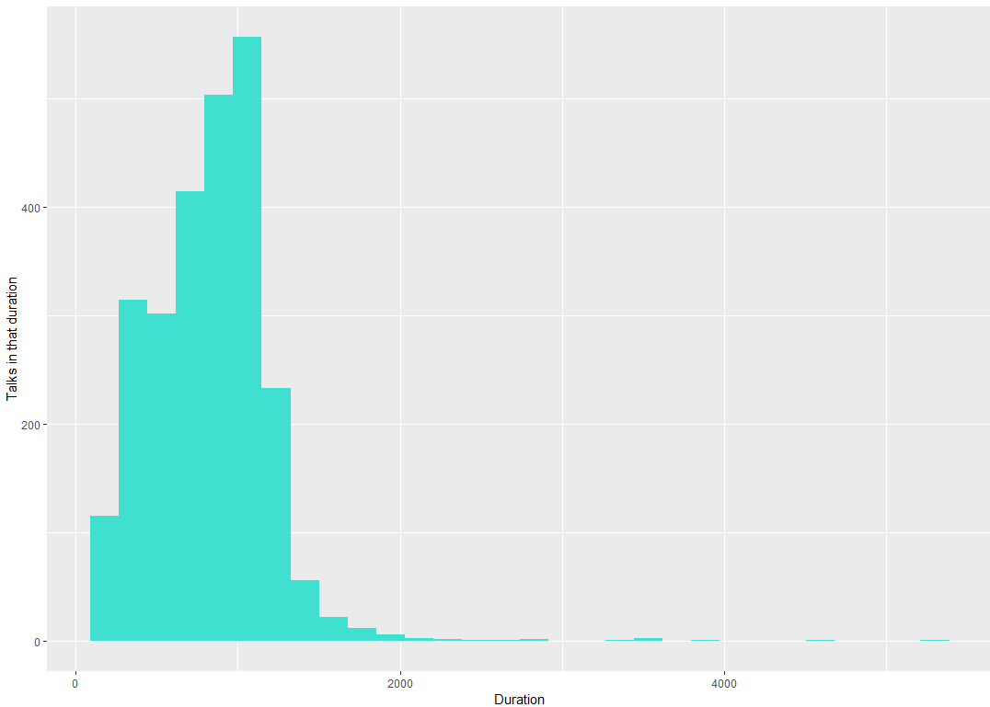
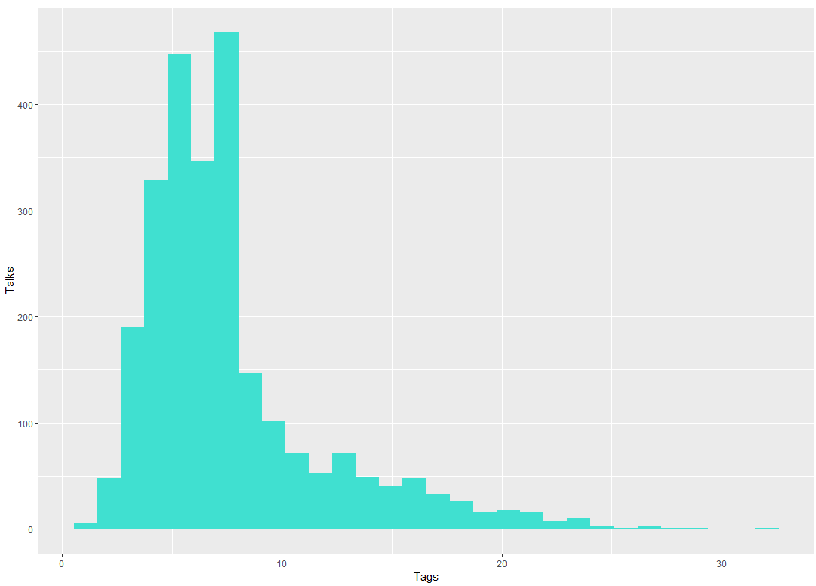
Recommendations from the Improved Model
No short Ted Talks video: Duration, a very slightly positive correlation shows the most popular talks being between 8-18 minutes. This indications that usually talks that are too short are not sufficiently deep to be inspiring enough.
High number of Tags: The regression suggested a positive effect for more tags, and suggested to view from more topics. The most popular talks have between 3-8 tags, so it’s not a good idea to have only focused themes but also broader ones.

Slide 24

Questions ?

